Slide 1
Responsible Web Design*
*Even haters admit these are “HTML5” technologies

Slide 2
Your Responsibility
Today is the age of feature detection.
Feature Detection != Browser Detection
It’s your responsibility!

Slide 3
Agenda
Your Responsibility
Polyfilling It
Using Modernizr

Slide 4
For each technology/feature
Duplicate the next 3 slides, then
** REMOVE THIS SLIDE **

Slide 5
Feature Description
Just ask the browser!
Then deliver the right experience!

Slide 6
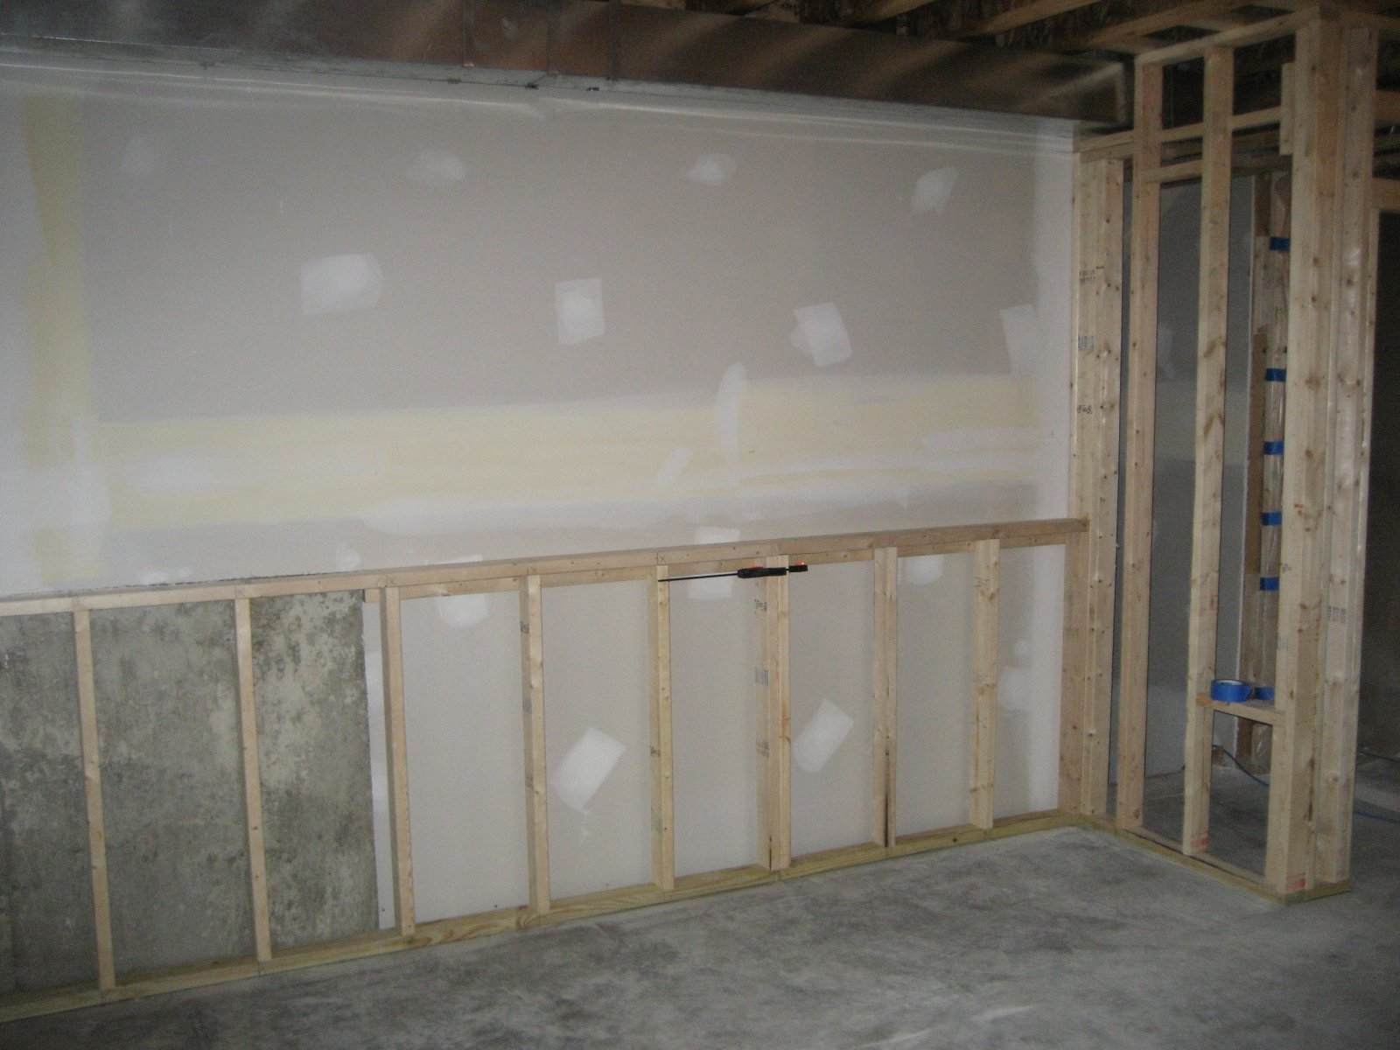
Add a little Spackle

Slide 7
Modernizr
Modernizr.load({
test: Modernizr.borderradius,
callback: function () { $('.roundedCornersAreCool').corner();
$('#myFigure').corner();
}
});

Slide 8








Browser Support for Feature X
 |  |  |  |  | Mobile
9 |  |  |  |  | 9

Slide 9
Questions?

